Slide 1
Chapter 15 Abstract Classes and Interfaces

Slide 2
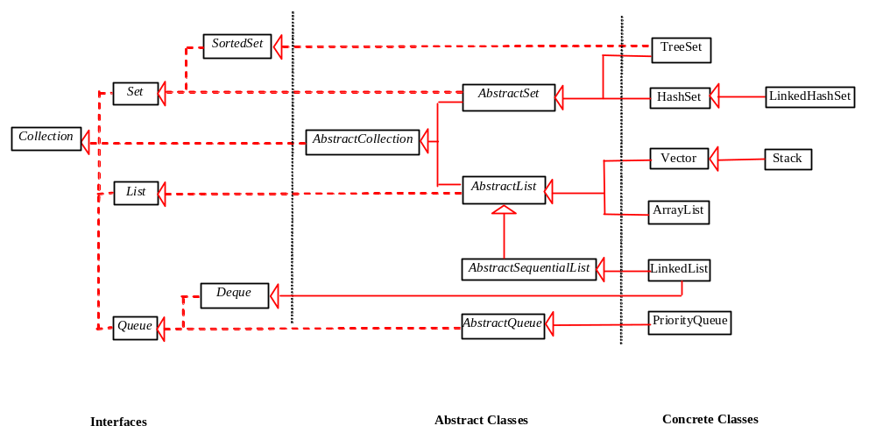
Motivation
Java Collection Framework hierarchy

Slide 3
Objectives
    To design and use abstract classes (§15.2).
    To generalize numeric wrapper classes, BigInteger, and BigDecimal using the abstract Number class (§15.3).
    To specify common behavior for objects using interfaces (§15.5).
    To define interfaces and define classes that implement interfaces (§15.5).
    To define a natural order using the Comparable interface (§15.6).
    To make objects cloneable using the Cloneable interface (§15.7).
    To explore the similarities and differences among concrete classes, abstract classes, and interfaces (§15.8).
    To design the Rational class for processing rational numbers (§15.9).

Slide 4
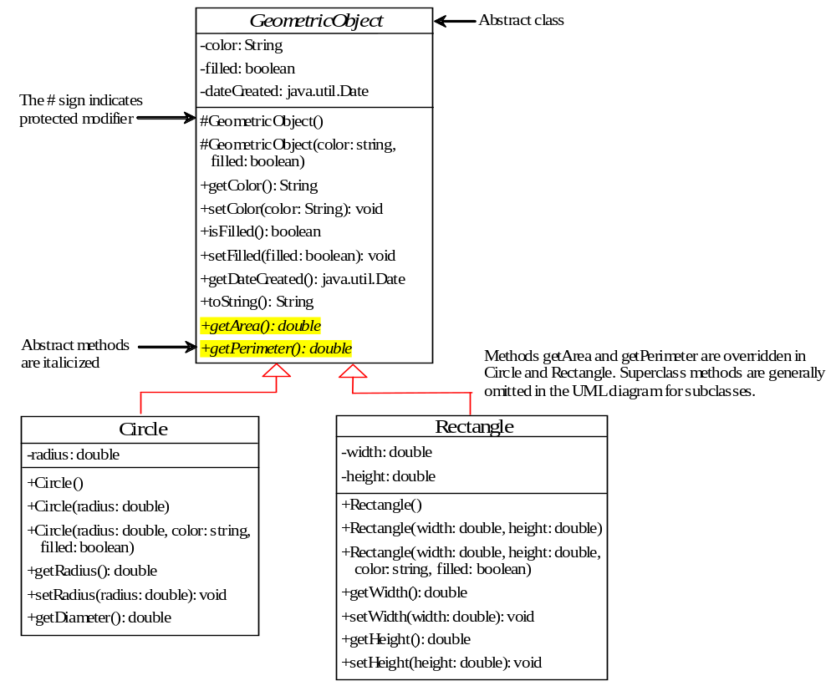
Abstract Classes and Abstract Methods
GeometricObject
Circle
Rectangle
TestGeometricObject
Run

Slide 5
abstract method in abstract class
An abstract method cannot be contained in a nonabstract class.
If a subclass of an abstract superclass does not implement all the abstract methods, the subclass must be defined abstract.
In other words, in a nonabstract subclass extended from an abstract class, all the abstract methods must be implemented, even if they are not used in the subclass.

Slide 6
object cannot be created from abstract class
An abstract class cannot be instantiated using the new operator,
but you can still define its constructors, which are invoked in the constructors of its subclasses.
For instance, the constructors of GeometricObject are invoked in the Circle class and the Rectangle class.

Slide 7
abstract class without abstract method
A class that contains abstract methods must be abstract.
However, it is possible to define an abstract class that contains no abstract methods.
In this case, you cannot create instances of the class using the new operator. This class is used as a base class for defining a new subclass.

Slide 8
superclass of abstract class may be concrete
A subclass can be abstract even if its superclass is concrete.
For example, the Object class is concrete, but its subclasses, such as GeometricObject, may be abstract.

Slide 9
concrete method overridden to be abstract
A subclass can override a method from its superclass to define it abstract.
This is rare, but useful when the implementation of the method in the superclass becomes invalid in the subclass.
In this case, the subclass must be defined abstract.

Slide 10
abstract class as type
You cannot create an instance from an abstract class using the new operator,
An abstract class can be used as a data type.
Therefore, the following statement, which creates an array whose elements are of GeometricObject type, is correct.
GeometricObject[] geo = new GeometricObject[10];

Slide 11
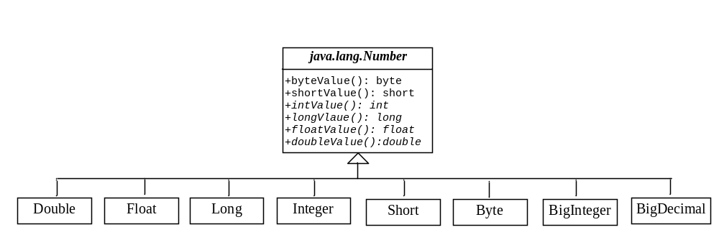
Case Study: the Abstract Number Class
LargestNumbers
Run

Slide 12
Interfaces
What is an interface?
Why is an interface useful?
How do you define an interface?
How do you use an interface?

Slide 13
What is an interface?
Why is an interface useful?
An interface is a classlike construct that contains only constants and abstract methods.
In many ways, an interface is similar to an abstract class, but the intent of an interface is to specify common behavior for objects.
For example, you can specify that the objects are comparable, edible, cloneable using appropriate interfaces.

Slide 14
Define an Interface
To distinguish an interface from a class, Java uses the following syntax to define an interface:
public interface InterfaceName {
constant declarations;
method signatures;
}
Example:
public interface Edible {
/** Describe how to eat */
public abstract String howToEat();
}

Slide 15
Interface is a Special Class
An interface is treated like a special class in Java.
Each interface is compiled into a separate bytecode file, just like a regular class.
Like an abstract class, you cannot create an instance from an interface using the new operator,
You can use an interface as a data type for a variable, as the result of casting, and so on.

Slide 16
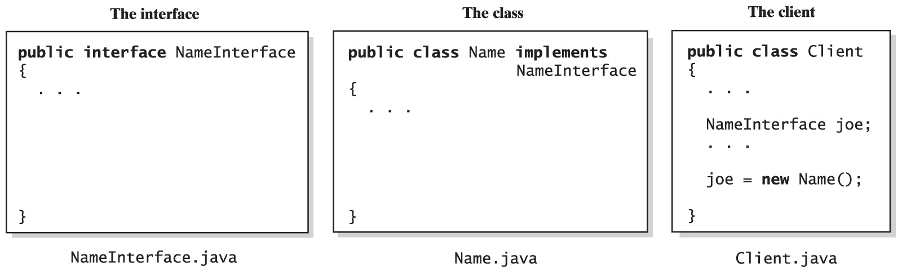
Implementing an Interface
Fig. 3-3 The files for an interface, a class that implements the interface, and the client.
Carrano, Data Structures and Abstractions with Java, Second Edition, (c) 2007 Pearson Education, Inc. All rights reserved. 0-13-237045-X

Slide 17
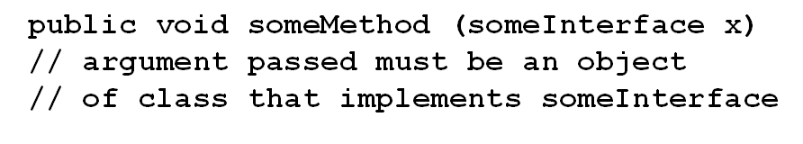
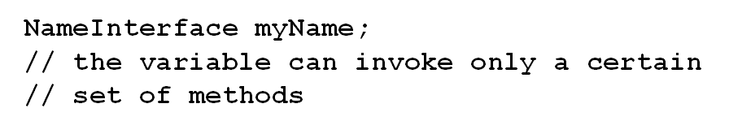
An Interface as a Data Type
An interface can be used as a data type
or …
Carrano, Data Structures and Abstractions with Java, Second Edition, (c) 2007 Pearson Education, Inc. All rights reserved. 0-13-237045-X

Slide 18
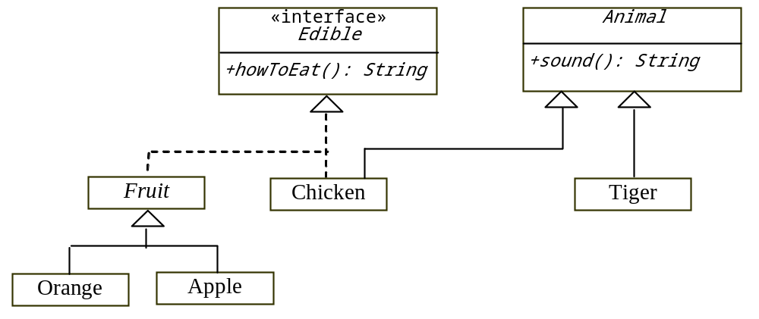
Example
You can now use the Edible interface to specify whether an object is edible. This is accomplished by letting the class for the object implement this interface using the implements keyword. For example, the classes Chicken and Fruit implement the Edible interface (See TestEdible).
Edible
TestEdible
Run

Slide 19
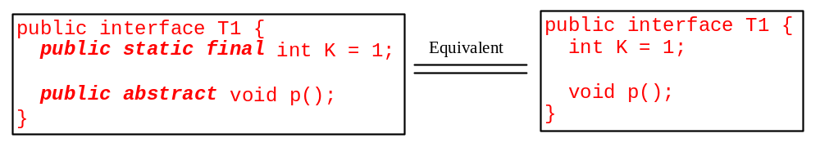
Omitting Modifiers in Interfaces
  All data fields are public final static and all methods are public abstract in an interface. For this reason, these modifiers can be omitted, as shown below:
  A constant defined in an interface can be accessed using syntax InterfaceName.CONSTANT_NAME (e.g., T1.K).

Slide 20
Example: The Comparable Interface
// This interface is defined in
// java.lang package
package java.lang;
public interface Comparable<E> {
public int compareTo(E o);
}

Slide 21
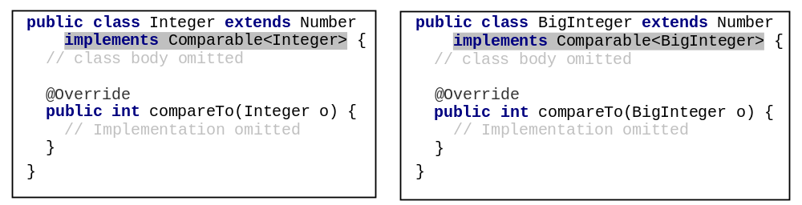
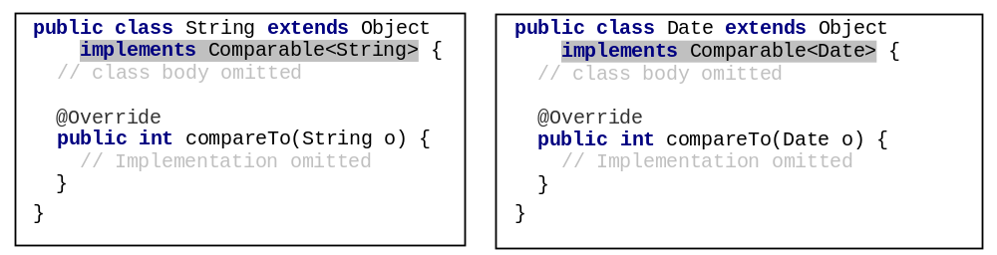
Integer and BigInteger Classes
String and Date Classes

Slide 22
Example
1 System.out.println(new Integer(3).compareTo(new Integer(5)));
2 System.out.println("ABC".compareTo("ABE"));
3 java.util.Date date1 = new java.util.Date(2013, 1, 1);
4 java.util.Date date2 = new java.util.Date(2012, 1, 1);
5 System.out.println(date1.compareTo(date2));

Slide 23
Generic max Method
Let n be an Integer object, s be a String object, and d be a Date object. All the following expressions are true.
SortComparableObjects
Run

Slide 24
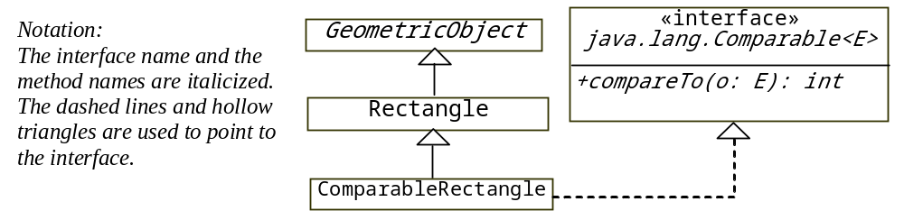
Defining Classes to Implement Comparable
ComparableRectangle
SortRectangles
Run

Slide 25
Interfaces vs. Abstract Classes
  In an interface, the data must be constants; an abstract class can have all types of data.
  Each method in an interface has only a signature without implementation; an abstract class can have concrete methods.
 | Variables | Constructors | Methods
Abstract class | No restrictions | Constructors are invoked by subclasses through constructor chaining. An abstract class cannot be instantiated using the new operator. | No restrictions.
Interface | All variables must be public static final | No constructors. An interface cannot be instantiated using the new operator. | All methods must be public abstract instance methods

Slide 26
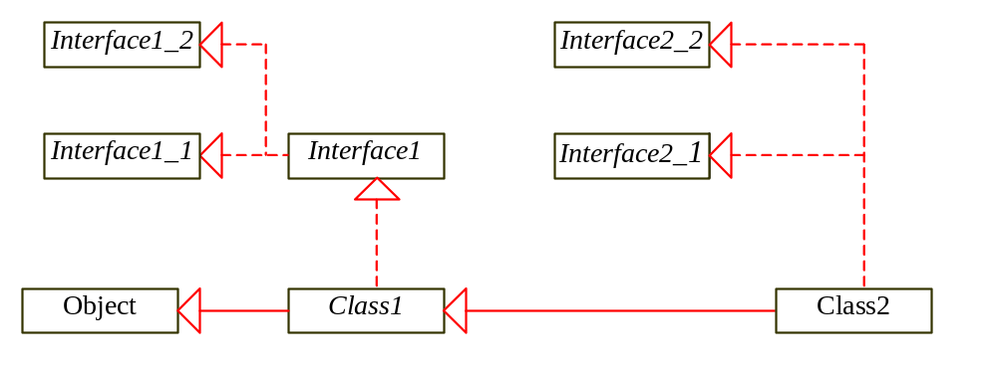
Interfaces vs. Abstract Classes, cont.
  All classes share a single root, the Object class, but there is no single root for interfaces.
  Like a class, an interface also defines a type. You can use an interface as a data type and cast a variable of an interface type to its subclass, and vice versa.
  Suppose that c is an instance of Class2. c is also an instance of Object, Class1, Interface1, Interface1_1, Interface1_2, Interface2_1, and Interface2_2.

Slide 27
Caution: conflict interfaces
  In rare occasions, a class may implement two interfaces with conflict information
    (e.g., two same constants with different values or two methods with same signature but different return type).
  This type of errors will be detected by the compiler.

Slide 28
Whether to use an interface or a class?
  Abstract classes and interfaces can both be used to model common features.
  How do you decide whether to use an interface or a class?
  In general, a strong is-a relationship that clearly describes a parent-child relationship should be modeled using classes.
  For example, a staff member is a person. So their relationship should be modeled using class inheritance.

Slide 29
Whether to use an interface or a class?
  A weak is-a relationship, also known as an is-kind-of relationship, indicates that an object possesses a certain property.
  A weak is-a relationship can be modeled using interfaces.
  For example, all strings are comparable, so the String class implements the Comparable interface.
  You can also use interfaces to circumvent single inheritance restriction if multiple inheritance is desired.
  In the case of multiple inheritance, you have to design one as a superclass, and others as interface.

Slide 30
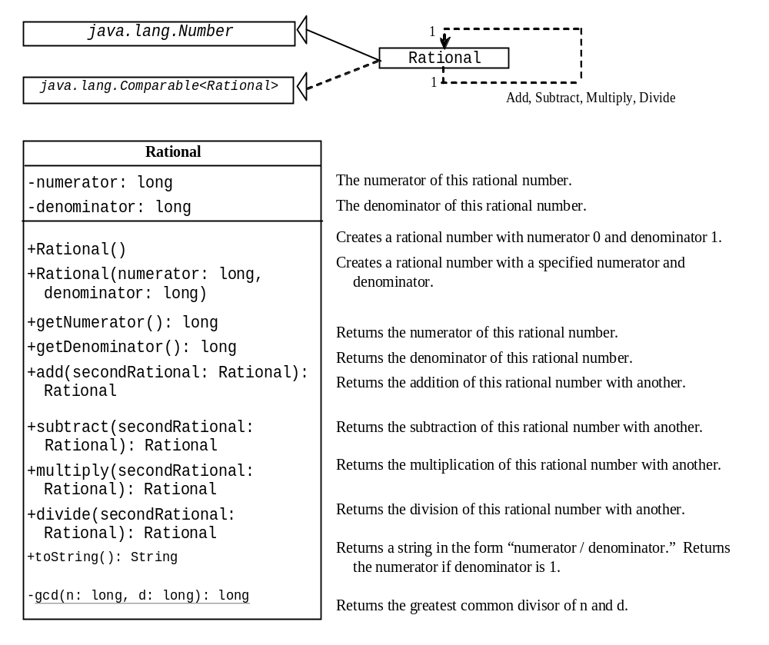
The Rational Class
Rational
TestRationalClass
Run

